Slide 1

2D Array
FALL 2019
Lecture : Multi dimensional arrays

Slide 2
Declare Array of following data type
byte[] anArrayOfBytes;
short[] anArrayOfShorts;
long[] anArrayOfLongs;
float[] anArrayOfFloats;

Slide 3
Declare Array of following data type
double[] anArrayOfDoubles;
boolean[] anArrayOfBooleans;
char[] anArrayOfChars;
String[] anArrayOfStrings;

Slide 4
Character & String Array
Character Array
char[] anArrayOfChars = {‘a’, ‘b’, ‘c’, ‘d’, ‘e’};
String Array
String myArray[] = { "one", "two", "three" };

Slide 5
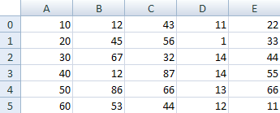
Two Dimensional Arrays
Array to hold more than one column
Example: Think spreadsheet with rows and columns. If have 6 rows and 5 column then your spreadsheet can hold 30 numbers

Slide 6
Two Dimensional Arrays
2D – Array Declare as
int[ ][ ] aryNumbers = new int[6][5];
The first set of square brackets is for the rows
Second set of square brackets is for the columns.
In the above line of code, we are telling Java to set up an array with 6 rows and 5 columns

Slide 7
Two Dimensional Arrays
Here's some code to fill the first rows of numbers from our spreadsheet image:
aryNumbers[0][0] = 10;
aryNumbers[0][1] = 12;
aryNumbers[0][2] = 43;
aryNumbers[0][3] = 11;
aryNumbers[0][4] = 22;

Slide 8
Two Dimensional Arrays
For inserting element in row 1
aryNumbers[1][0] = 20;
aryNumbers[1][1] = 45;
aryNumbers[1][2] = 56;
aryNumbers[1][3] = 1;
aryNumbers[1][4] = 33;

Slide 9
Another Way For Two Dimensional Arrays declaration and creation
long[][] itemNumbers = new long[][] {
{ 947783, 934687, 973947, 987598, 974937 },
{ 739579, 367583, 743937, 437657, 467945 } };

Slide 10
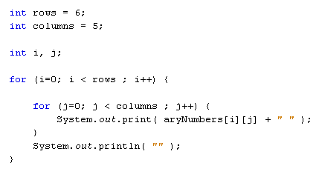
Two Dimensional Arrays
For accessing two dimensional arrays

Slide 11
Multi Dimensional Arrays
double[][][] numbers = new double[2][3][5];
Above statement declare and create 3 dimensional arrays
So to add one more dimension add one more square bracket
Above statement store 2*3*5=30 elements

Slide 12
Multi Dimensional Arrays
To better understand previous example,
Consider that the left square brackets represent a page in a book,
The middle square brackets represent a table drawn on the page,
And the right square brackets represent each item in the table.
For accessing previous multi dimensional array
numbers[0][0][0] = 12.44;

Slide 13
Passing Two Dimensional Arrays as Argument
public void showPoints(int[][] Coords)
{
// Do code
}
In same manner you can pass multi dimensional array by adding more square bracket.

Slide 14
Passing Two Dimensional Arrays as Argument
public int[][] CreateTriangle() {
int[][] values = new int[3][2];
return values;
}
In same manner you can pass multi dimensional array by adding more square bracket.

Slide 15
Ragged / jagged Arrays
Two dimensional array is of M*N rectangular array
Output be of two dimensional M*N
There can also be a way where column size of each row can be different in two dimensional array called as Ragged array

Slide 16
Code Example Ragged Array
public static void main(String[] args) {
//Declare, Initialize, and fill the array
int[][] array = {{0,1,2,3,4},
{0,1,2},
{0,1,2,3},
{0,1},
{0},
{0},
{0,1,2,3,4,5},
{0},
{0,1,2,3},
{0,1,2,3}};
//Test the array
for (int i = 0; i<array.length; i++) {
for (int j = 0; j<array[i].length; j++) {
System.out.print(array[i][j] + " ");
}
System.out.println();
}
}

Slide 17
Code Example Ragged Array
Output for previous code is
0 1 2 3 4
0 1 2
0 1 2 3
0 1
0
0
0 1 2 3 4 5
0
0 1 2 3
0 1 2 3

Slide 18
Write a program which create 4 by 4 2D array. Take values in 2D array from the user and pass the 2D array into a function which return maximum number in the 2Darray

